Slide 1


Personal development Plan
Unit 2.1 Formulation of personal vision statement
Prepared by the research team

Slide 2
Welcome!!
Unit 2.1 Formulation of personal vision statement

Slide 3
Learning outcome
01
Students will be able to formulate personal vision.

Slide 4


Slide 5
What is personal vision ?
A clear personal vision is an integration of your abilities, interests, personality, values, goals, skills/experience, family of origin, and stage of adult development.
A vision is a practical guide for creating plans, setting goals and objectives, making decisions, and coordinating and evaluating the work on any project, large or small.

Slide 6
Why personal vision is required ?
A vision helps keep you focused and together, especially with complex projects and in stressful times.

Slide 7
Why personal vision is important ?
Before you can achieve it you must dream it. ... Living with purpose brings energy to your life each day and keeps your spirits high as you do the necessary task and stay on course to reach your dreams.

Slide 8

But why personal vision / what are the benefits of this ?

Slide 9
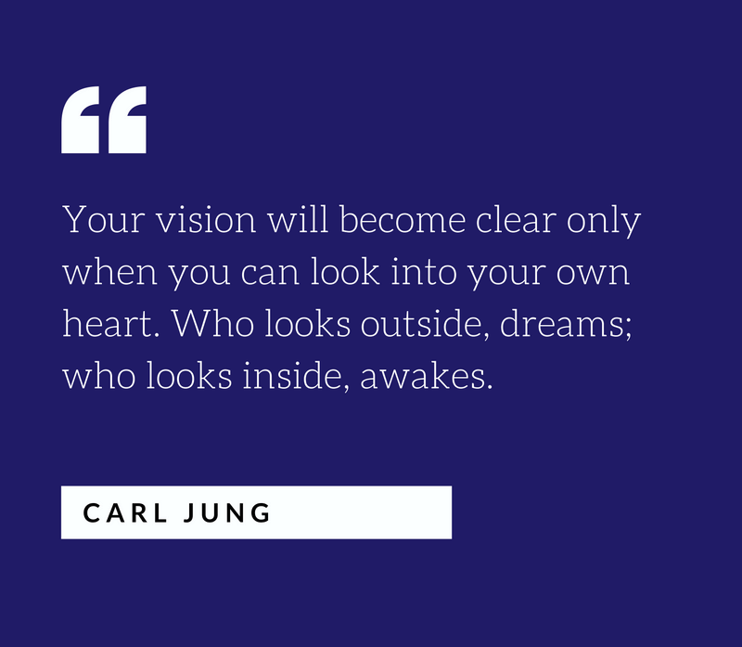

Slide 10
Read given article in folder on how to craft personal vision
&
Write down your own personal vision statement in 20 to 30 words

